Slide 1
Signal Processing First
Lecture 11
Linearity & Time-Invariance
Convolution
© 2003, JH McClellan & RW Schafer

Slide 2
READING ASSIGNMENTS
This Lecture:
  Chapter 5, Sections 5-5 and 5-6
    Section 5-4 will be covered, but not “in depth”
Other Reading:
  Recitation: Ch. 5, Sects 5-6, 5-7 & 5-8
    CONVOLUTION
  Next Lecture: start Chapter 6
© 2003, JH McClellan & RW Schafer

Slide 3
LECTURE OBJECTIVES
GENERAL PROPERTIES of FILTERS
  LINEARITY
  TIME-INVARIANCE
  ==> CONVOLUTION
LTI SYSTEMS
  BLOCK DIAGRAM REPRESENTATION
    Components for Hardware
    Connect Simple Filters Together to Build More Complicated Systems
© 2003, JH McClellan & RW Schafer

Slide 4
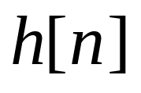
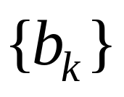
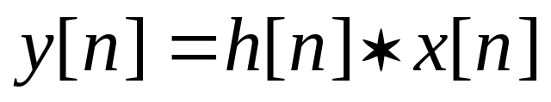
OVERVIEW
IMPULSE RESPONSE,
  FIR case: same as
CONVOLUTION
  GENERAL:
  GENERAL CLASS of SYSTEMS
  LINEAR and TIME-INVARIANT
ALL LTI systems have h[n] & use convolution
© 2003, JH McClellan & RW Schafer

Slide 5
DIGITAL FILTERING
CONCENTRATE on the FILTER (DSP)
DISCRETE-TIME SIGNALS
  FUNCTIONS of n, the “time index”
  INPUT x[n]
  OUTPUT y[n]
x(t)
A-to-D
x[n]
FILTER
y[n]
D-to-A
y(t)
© 2003, JH McClellan & RW Schafer

Slide 6
BUILDING BLOCKS
BUILD UP COMPLICATED FILTERS
  FROM SIMPLE MODULES
  Ex: FILTER MODULE MIGHT BE 3-pt FIR
x[n]
OUTPUT
y[n]
FILTER
FILTER
+
INPUT
+
FILTER
© 2003, JH McClellan & RW Schafer

Slide 7
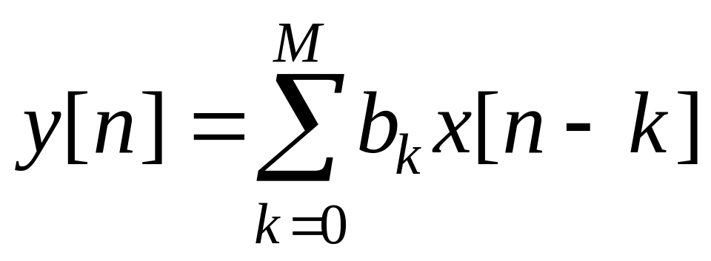
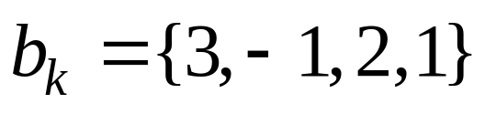
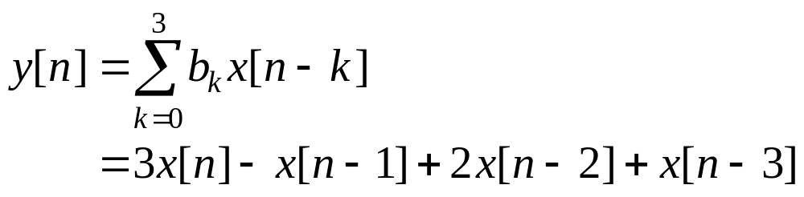
GENERAL FIR FILTER
FILTER COEFFICIENTS {b_{k}}
  DEFINE THE FILTER
  For example,
© 2003, JH McClellan & RW Schafer

Slide 8
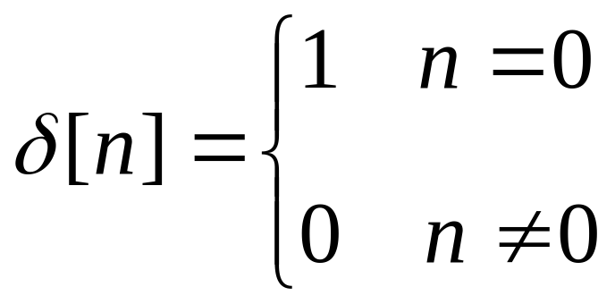
SPECIAL INPUT SIGNALS
x[n] = SINUSOID
x[n] has only one NON-ZERO VALUE
FREQUENCY RESPONSE
UNIT-IMPULSE
1
n
© 2003, JH McClellan & RW Schafer

Slide 9
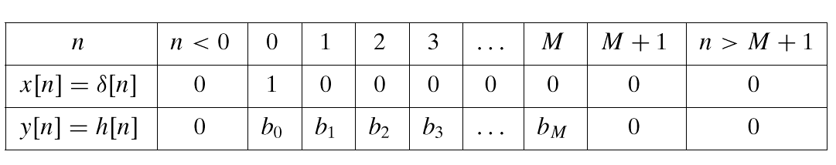
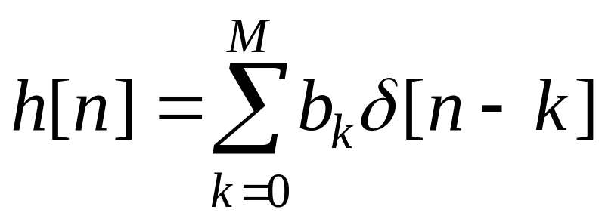
FIR IMPULSE RESPONSE
Convolution = Filter Definition
  Filter Coeffs = Impulse Response
© 2003, JH McClellan & RW Schafer

Slide 10
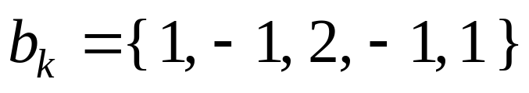
MATH FORMULA for h[n]
Use SHIFTED IMPULSES to write h[n]
2
1
0
4
n
–1
© 2003, JH McClellan & RW Schafer

Slide 11
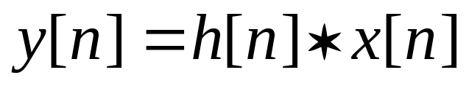
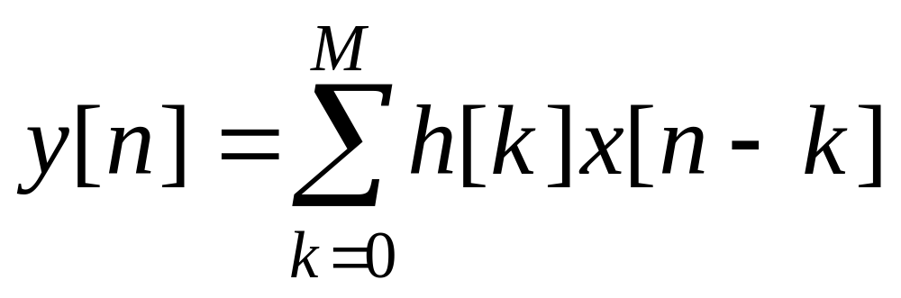
LTI: Convolution Sum
Output = Convolution of x[n] & h[n]
  NOTATION:
  Here is the FIR case:
FINITE LIMITS
Same as b_{k}
FINITE LIMITS
© 2003, JH McClellan & RW Schafer

Slide 12
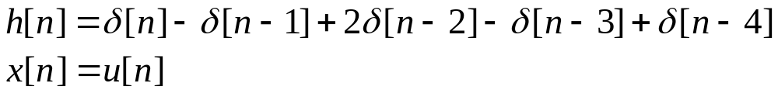
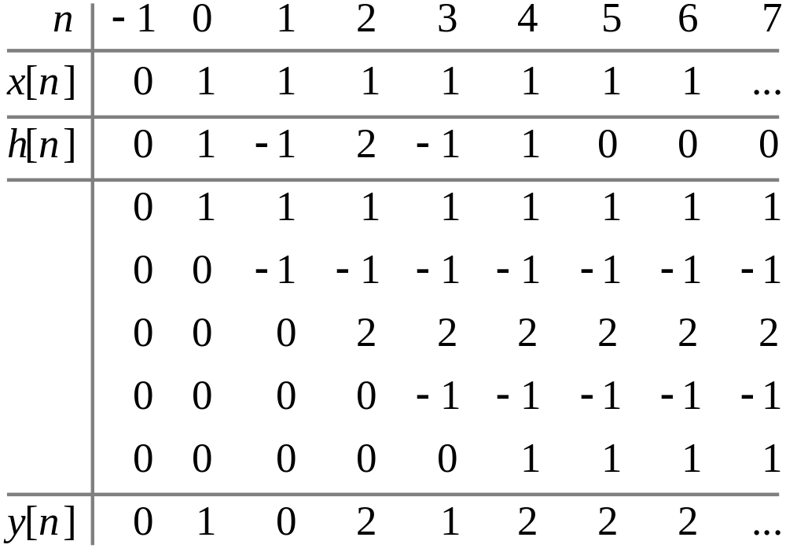
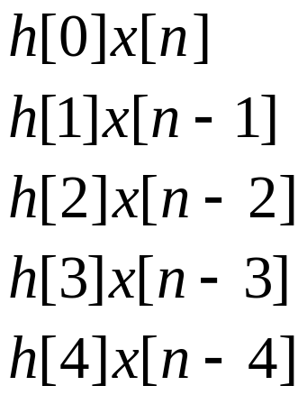
CONVOLUTION Example
© 2003, JH McClellan & RW Schafer

Slide 13
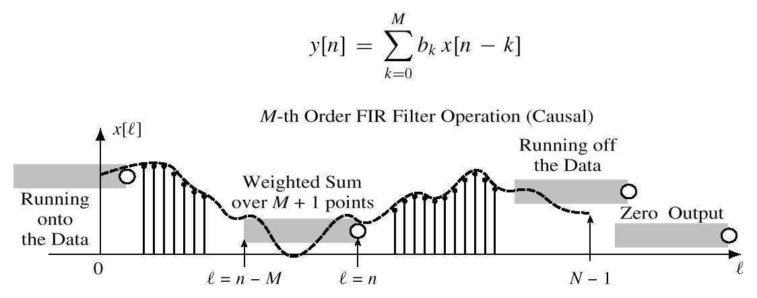
GENERAL FIR FILTER
SLIDE a Length-L WINDOW over x[n]
x[n-M]
x[n]
© 2003, JH McClellan & RW Schafer

Slide 14
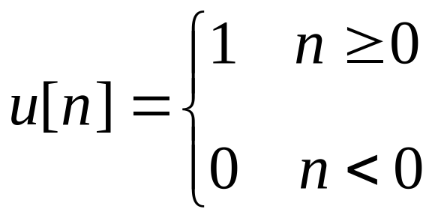
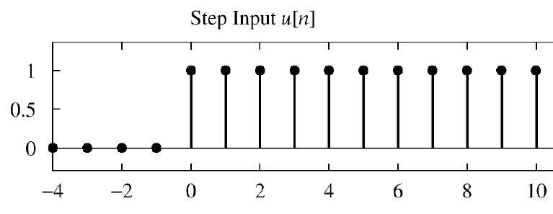
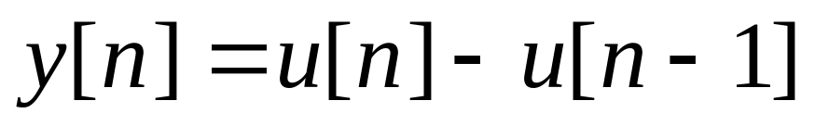
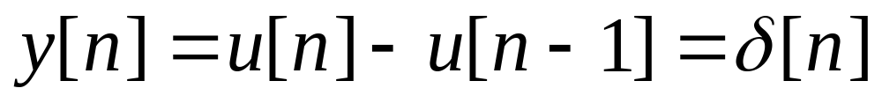
POP QUIZ
FIR Filter is “FIRST DIFFERENCE”
  y[n] = x[n] - x[n-1]
INPUT is “UNIT STEP”
Find y[n]
© 2003, JH McClellan & RW Schafer

Slide 15
HARDWARE STRUCTURES
INTERNAL STRUCTURE of “FILTER”
  WHAT COMPONENTS ARE NEEDED?
  HOW DO WE “HOOK” THEM TOGETHER?
SIGNAL FLOW GRAPH NOTATION
x[n]
FILTER
y[n]
© 2003, JH McClellan & RW Schafer

Slide 16
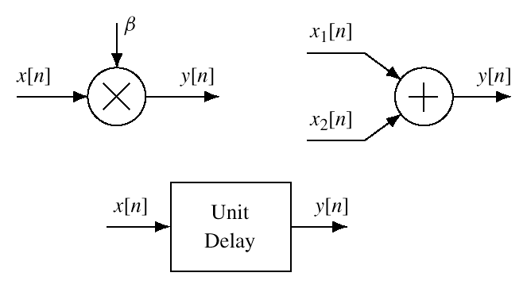
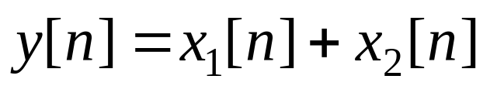
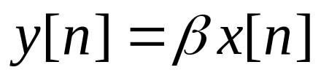
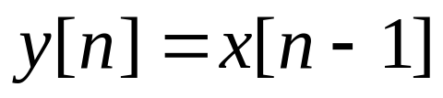
HARDWARE ATOMS
Add, Multiply & Store
© 2003, JH McClellan & RW Schafer

Slide 17
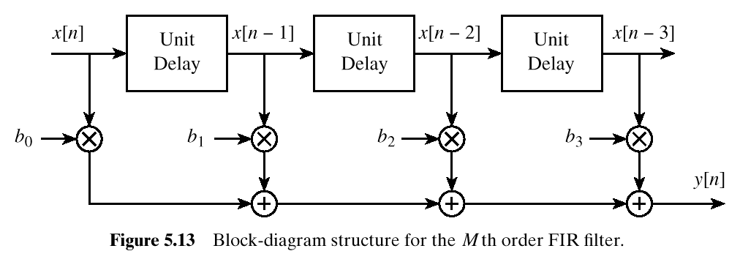
FIR STRUCTURE
Direct Form
SIGNAL
FLOW GRAPH
© 2003, JH McClellan & RW Schafer

Slide 18
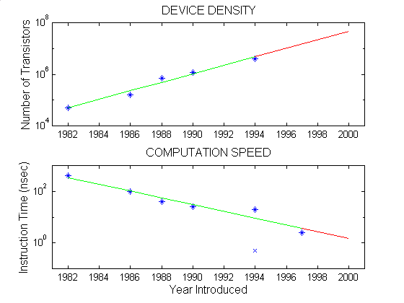
Moore’s Law for TI DSPs
LOG SCALE
Double every
18 months ?
© 2003, JH McClellan & RW Schafer

Slide 19
SYSTEM PROPERTIES
MATHEMATICAL DESCRIPTION
TIME-INVARIANCE
LINEARITY
CAUSALITY
  “No output prior to input”
x[n]
SYSTEM
y[n]
© 2003, JH McClellan & RW Schafer

Slide 20
TIME-INVARIANCE
IDEA:
  “Time-Shifting the input will cause the same time-shift in the output”
EQUIVALENTLY,
  We can prove that
    The time origin (n=0) is picked arbitrary
© 2003, JH McClellan & RW Schafer

Slide 21
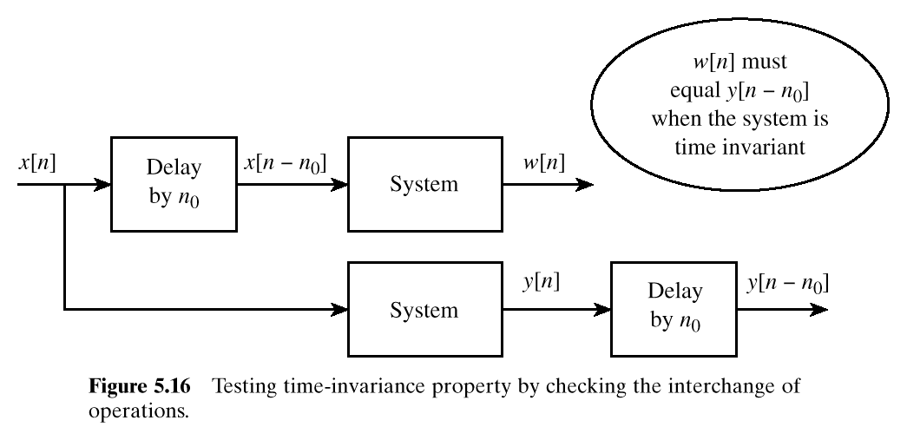
TESTING Time-Invariance
© 2003, JH McClellan & RW Schafer

Slide 22
LINEAR SYSTEM
LINEARITY = Two Properties
SCALING
  “Doubling x[n] will double y[n]”
SUPERPOSITION:
  “Adding two inputs gives an output that is the sum of the individual outputs”
© 2003, JH McClellan & RW Schafer

Slide 23
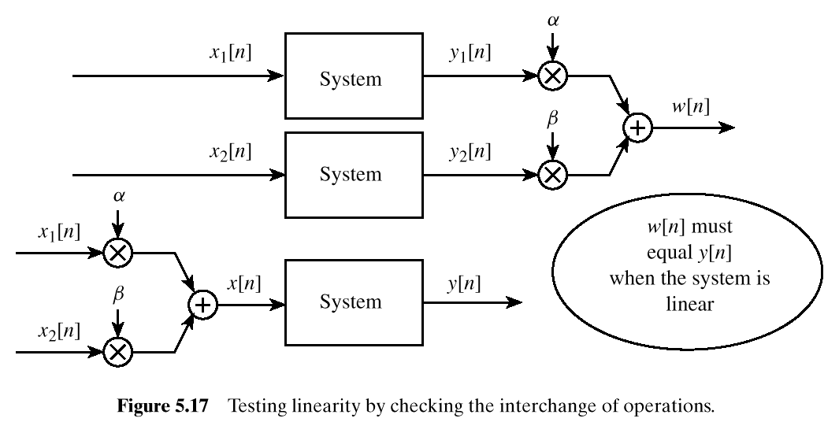
TESTING LINEARITY
© 2003, JH McClellan & RW Schafer

Slide 24
LTI SYSTEMS
LTI: Linear & Time-Invariant
COMPLETELY CHARACTERIZED by:
  IMPULSE RESPONSE h[n]
  CONVOLUTION: y[n] = x[n]*h[n]
    The “rule”defining the system can ALWAYS be re-written as convolution
FIR Example: h[n] is same as b_{k}
© 2003, JH McClellan & RW Schafer

Slide 25
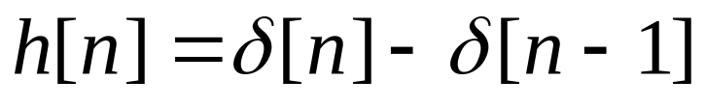
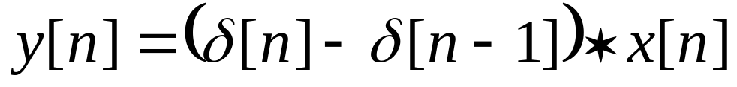
POP QUIZ
FIR Filter is “FIRST DIFFERENCE”
  y[n] = x[n] - x[n -1]
Write output as a convolution
  Need impulse response
  Then, another way to compute the output:
© 2003, JH McClellan & RW Schafer

Slide 26
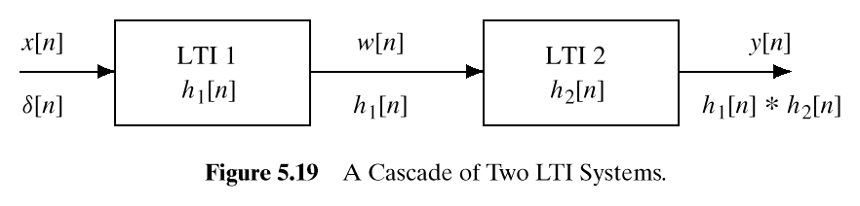
CASCADE SYSTEMS
Does the order of S₁ & S₂ matter?
  NO, LTI SYSTEMS can be rearranged !!!
  WHAT ARE THE FILTER COEFFS? {b_{k}}
S₁
S₂
© 2003, JH McClellan & RW Schafer

Slide 27
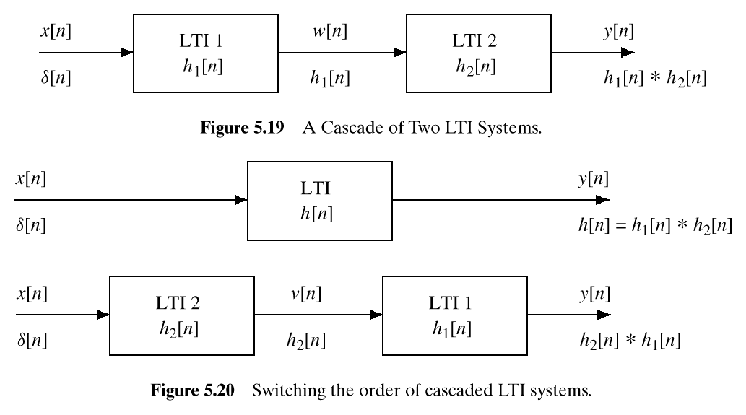
CASCADE EQUIVALENT
  Find “overall” h[n] for a cascade ?
S₁
S₂
S₂
S₁
© 2003, JH McClellan & RW Schafer

Slide 28
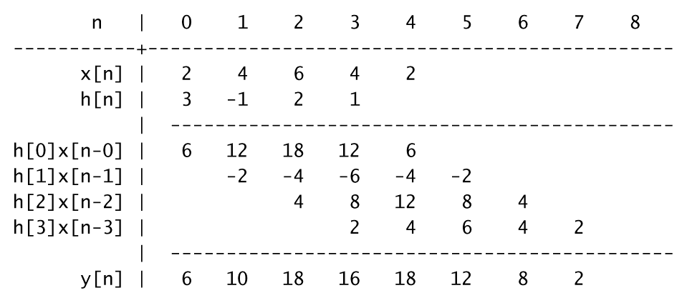
CONVOLUTION Example
© 2003, JH McClellan & RW Schafer

